Slide 1
Service Provider
AU’2021
We Provide On Demand!!!

Slide 2
Team Mentor: Sai Teja Reddy
Team Members:
Rajesh Uppala
Kaushik Kandikonda
Himanshu Jain
MD Shadaab Farhan

Slide 3





Tech Stack:

Slide 4
Requirements:
1. Register/login as service provider
2. Register/login as customer
Service provider should be able to
Create services which he provides ( should be dynamic to allow any kind of service )
Example: Define the service terms and warranty details
Cost and tax details
Ability to view reports of sales
Download in excel or pdf
Update the status . started / completed
Customer should be able to
View orders and filter by category and price range
Order a service
View previous orders ( view / download ) ( based on filters )
Rate orders ( only if status is completed )
Common:
Search feature wherever necessary
Define discounts and Discount period

Slide 5
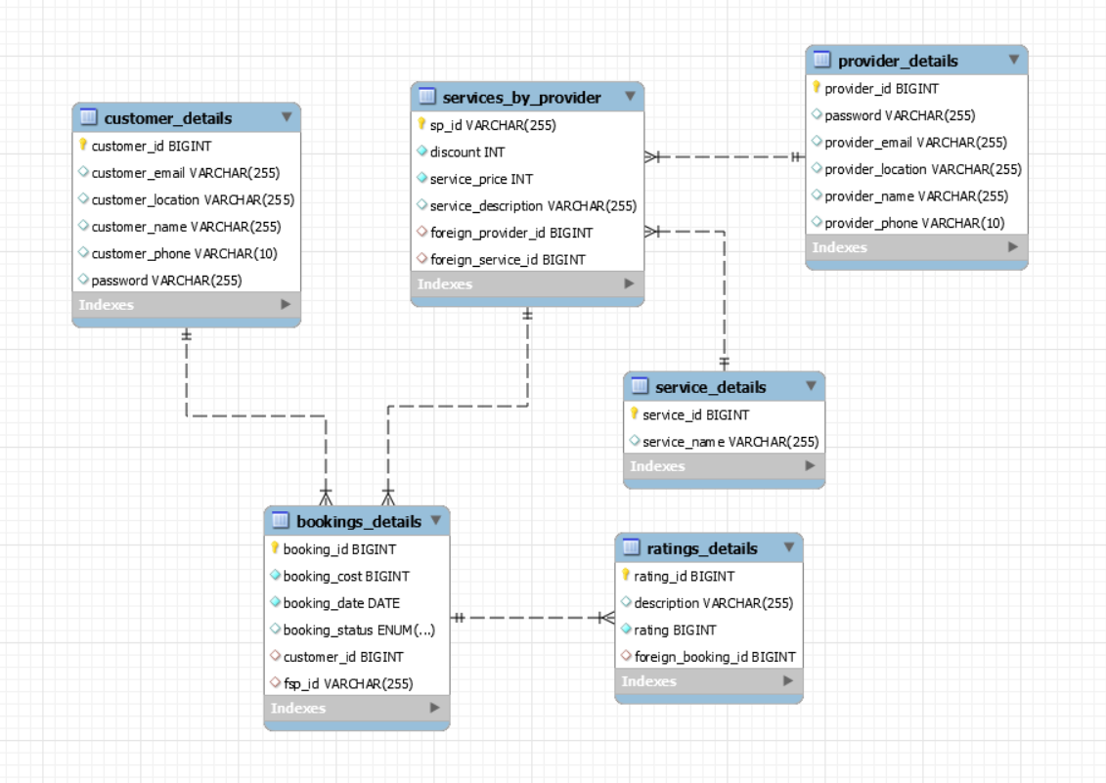
Database:

Slide 6
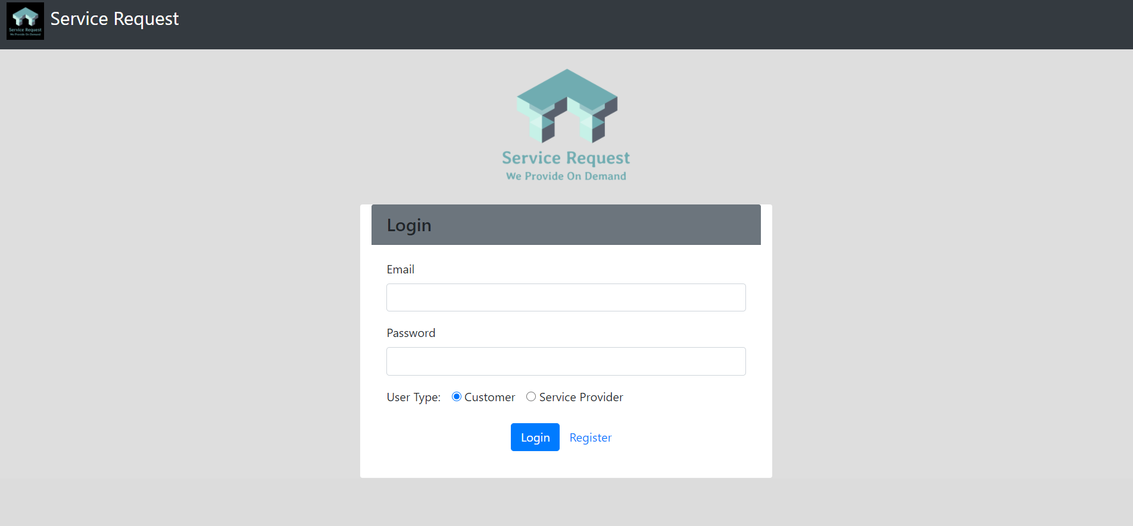
UI Login:

Slide 7
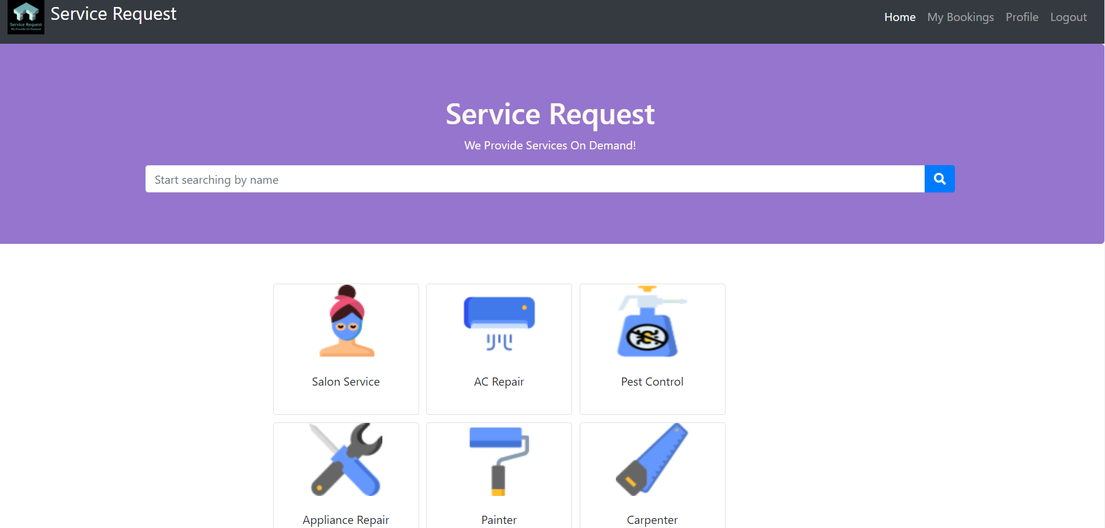
Customer UI:

Slide 8
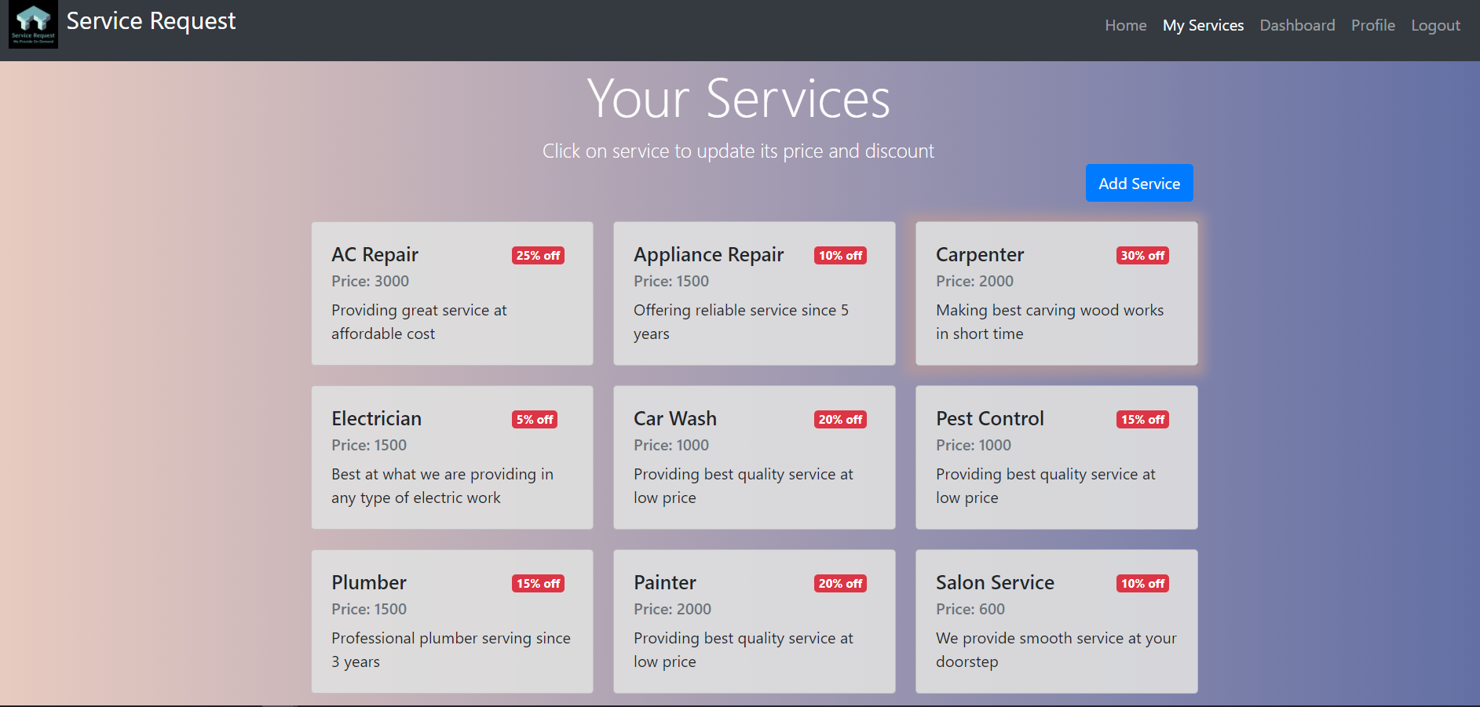
Provider UI:

Slide 9
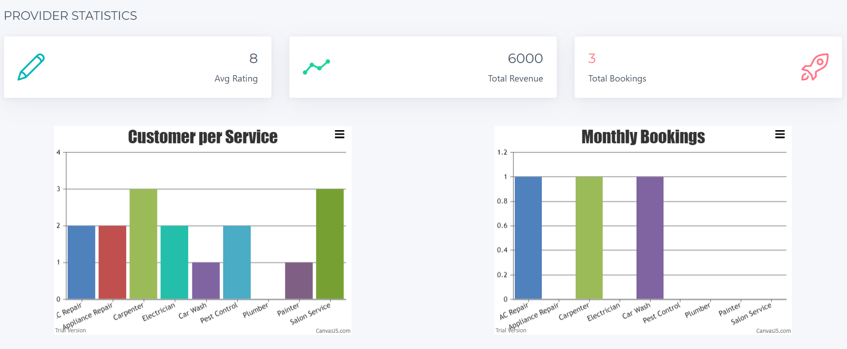
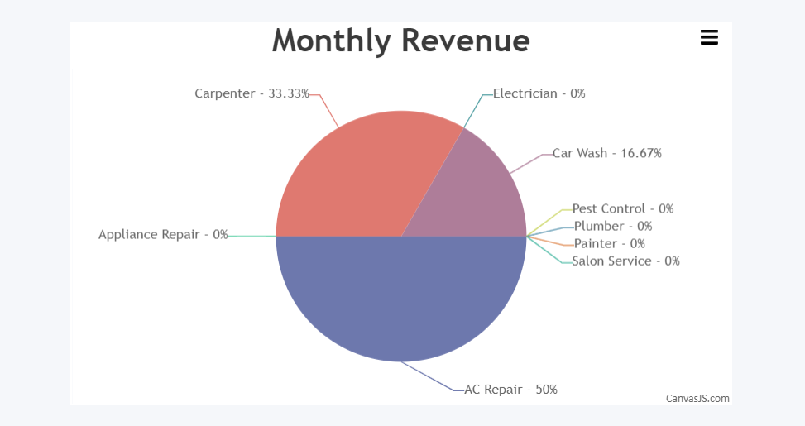
Reports:

Slide 10
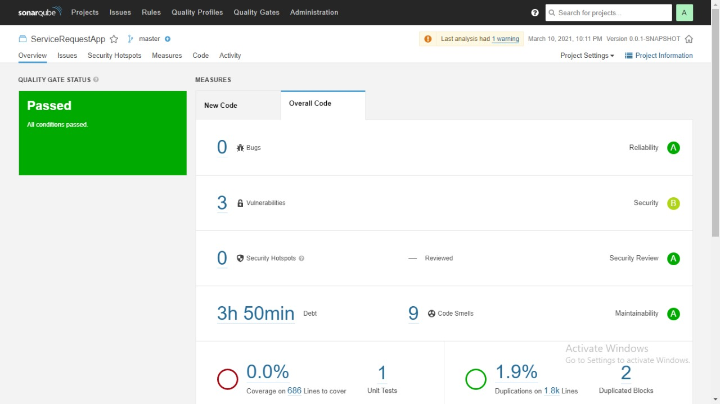
SonarQube Report(Backend):

Slide 11
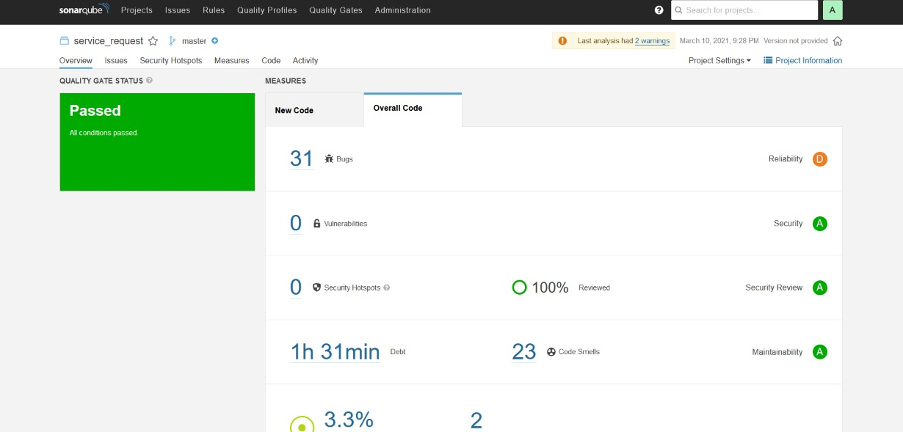
SonarQube Report(Frontend):

Slide 12
Thank You!!!!

